Slide 1
Class 12 - Virtual Memory (2)
Osama Hosam Eldeen
Taiba University

Slide 2
Inverted page tables
Problem:
  Page table overhead increases with address space size
  Page tables get too big to fit in memory!
Consider a computer with 64 bit addresses
  Assume 4 Kbyte pages (12 bits for the offset)
  Virtual address space = 2⁵² pages!
  Page table needs 2⁵² entries!
  This page table is much too large for memory!
    Many peta-bytes per process page table

Slide 3
Inverted page tables
How many mappings do we need (maximum) at any time?

Slide 4
Inverted page tables
How many mappings do we need (maximum) at any time?
We only need mappings for pages that are in memory!
  A 256 Kbyte memory can only hold 64 4Kbyte pages
  Only need 64 page table entries on this computer!

Slide 5
Inverted page tables
An inverted page table
  Has one entry for every frame of memory
  Records which page is in that frame
  Is indexed by frame number not page number!
So how can we search an inverted page table on a TLB miss fault?

Slide 6
Inverted page tables
If we have a page number (from a faulting address) and want to find its page table entry, do we
  Do an exhaustive search of all entries?

Slide 7
Inverted page tables
If we have a page number (from a faulting address) and want to find it page table entry, do we
  Do an exhaustive search of all entries?
  No, that’s too slow!
  Why not maintain a hash table to allow fast access given a page number?
    O(1) lookup time with a good hash function

Slide 8
Hash Tables
Data structure for associating a key with a value
  Perform hash function on key to produce a hash
  Hash is a number that is used as an array index
  Each element of the array can be a linked list of entries (to handle collisions)
  The list must be searched to find the required entry for the key (entry’s key matches the search key)
  With a good hash function the list length will be very short

Slide 9
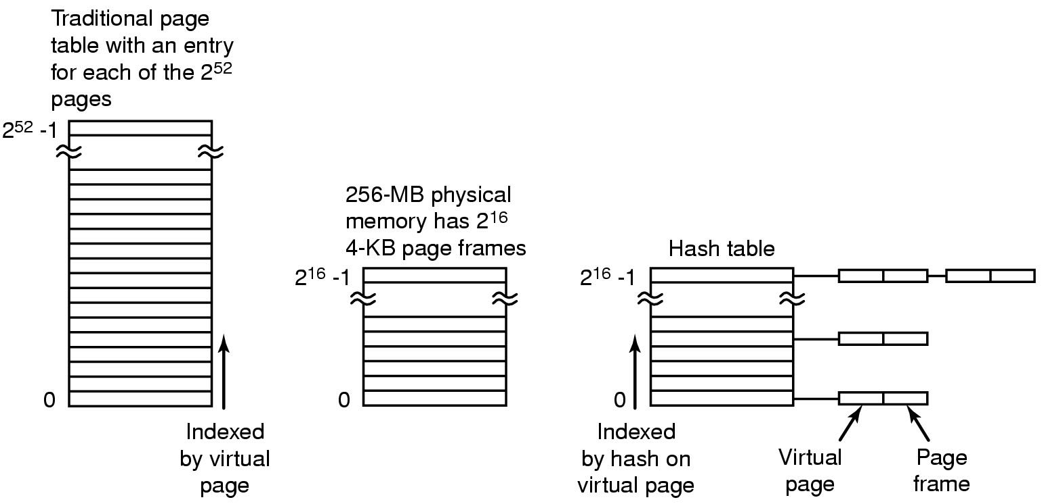
Inverted page table

Slide 10
Which page table design is best?
The best choice depends on CPU architecture
64 bit systems need inverted page tables
Some systems use a combination of regular page tables together with segmentation (later)

Slide 11
Memory protection
Protection though addressability
  If address translation only allows a process to access its own pages, it is implementing memory protection
But what if you want a process to be able to read and execute some pages but not write them?
  text segment
Or read and write them but not execute them?
  stack
Need some way of implementing protection based on access type

Slide 12
Memory protection
How is protection checking implemented?
  compare page protection bits with process capabilities and operation types on every load/store
  sounds expensive!
  Requires hardware support!
How can protection checking be done efficiently?
  Use the TLB as a “protection” look-aside buffer as well as a translation lookaside buffer
  Use special segment registers

Slide 13
Protection lookaside buffer
A TLB is often used for more than just “translation”
Memory accesses need to be checked for validity
  Does the address refer to an allocated segment of the address space?
    If not: segmentation fault!
  Is this process allowed to access this memory segment?
    If not: segmentation/protection fault!
  Is the type of access valid for this segment?
    Read, write, execute …?
    If not: protection fault!

Slide 14
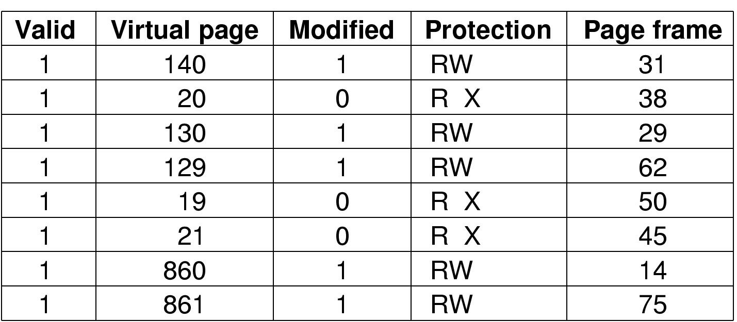
Page-grain protection checking with a TLB

Slide 15

Page grain protection in a page table
A typical page table entry with support for
page grain protection

Slide 16
Memory protection granularity
At what granularity should protection be implemented?
page-level?
  A lot of overhead for storing protection information for non-resident pages
segment level?
  Coarser grain than pages
  Makes sense if contiguous groups of pages share the same protection status

Slide 17
Segment-grain protection
All pages within a segment usually share the same protection status
  So we should be able to batch the protection information
Then why not just use segment-size pages?

Slide 18
Segment-grain protection
All pages within a segment usually share the same protection status
  So we should be able to batch the protection information
Then why not just use segment-size pages?
  Segments vary in size from process to process
  Segments change size dynamically (stack, heap etc)
Need to manage addressability, access-based protection and memory allocation separately
  Coarse-grain protection can be implemented simply through addressability

Slide 19
Segmented address spaces
Traditional Virtual Address Space
  “flat” address space (1 dimensional)
Segmented Address Space
  Program made of several pieces or “segments”
  Each segment is its own mini-address space
  Addresses within a segment start at zero
  The program must always say which segment it means
    either embed a segment id in an address
    or load a value into a segment register and refer to the register
  Addresses:
    Segment + Offset
  Each segment can grow independently of others

Slide 20

Segmentation in a single address space
Example: A compiler

Slide 21
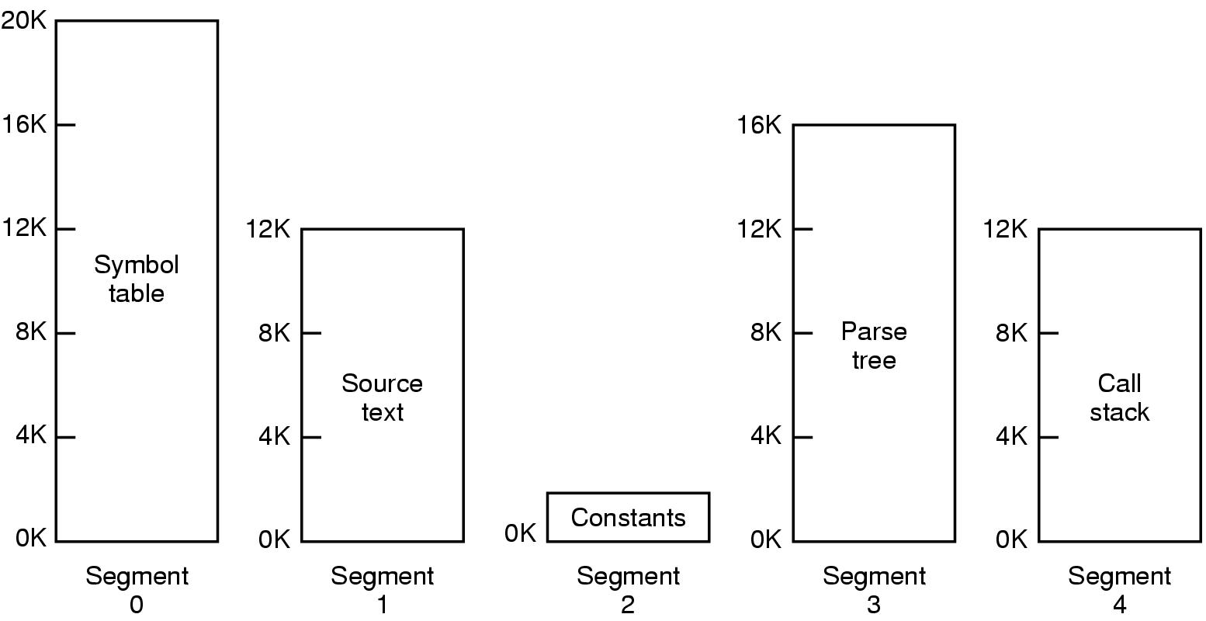
Segmented memory
Each space grows, shrinks independently!

Slide 22
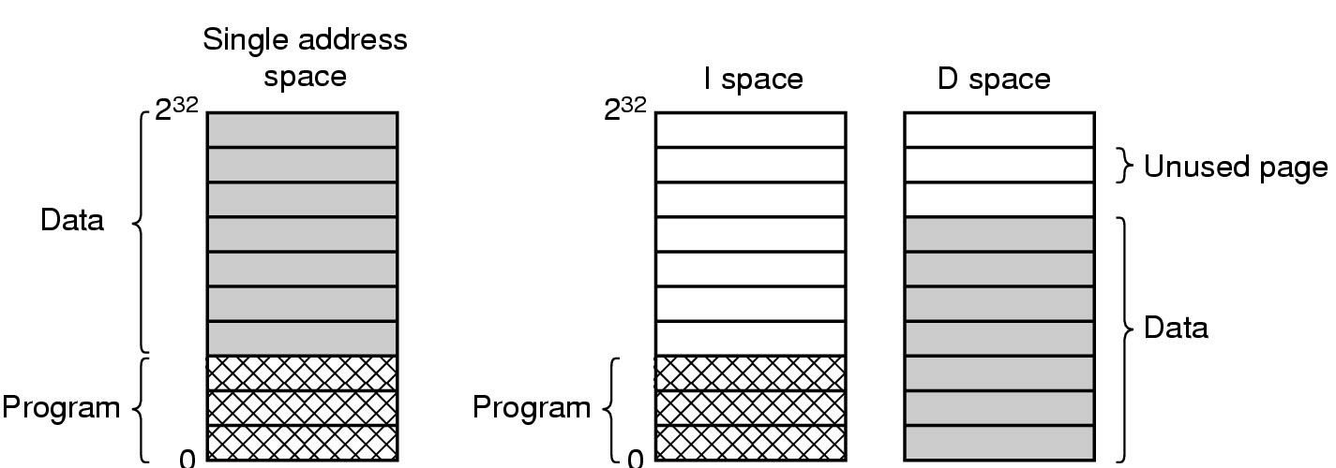
Separate instruction and data spaces
* One address space * Separate I and D spaces

Slide 23

Comparison of paging vs. segmentation

Slide 24
Segmentation vs. Paging
Do we need to choose one or the other?
Why not use both together
  Paged segments
  Paging for memory allocation
  Segmentation for maintaining protection information at a coarse granularity
  Segmentation and paging in combination for translation

Slide 25
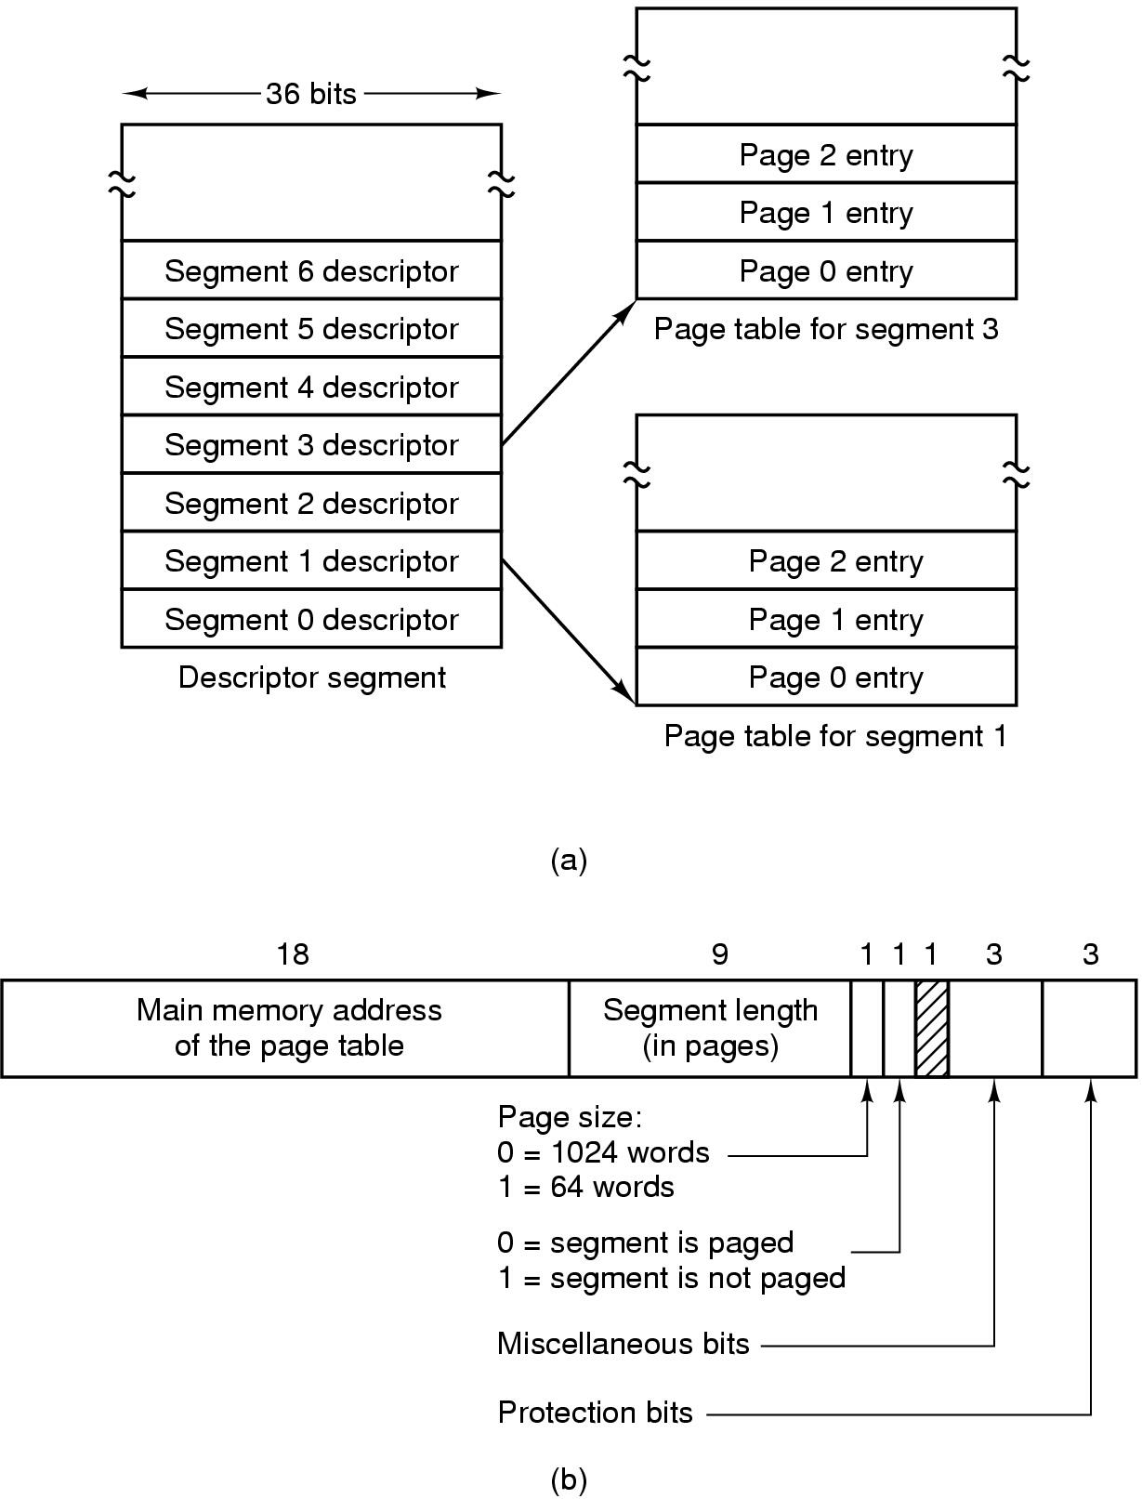
Segmentation with paging (MULTICS)
Each segment is divided up into pages.
Each segment descriptor points to a page table.

Slide 26
Segmentation with paging (MULTICS)
Each entry in segment table...

Slide 27
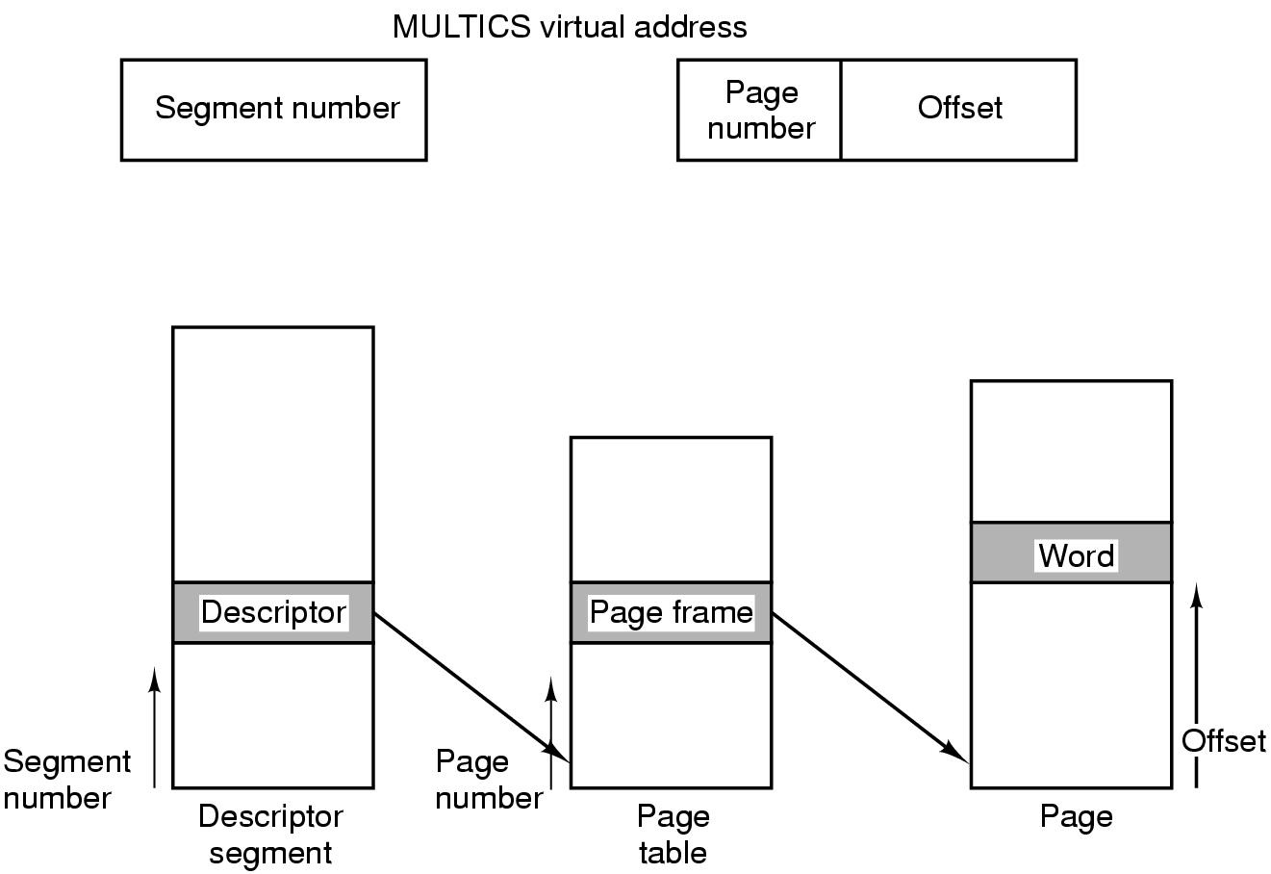
Segmentation with paging: MULTICS
Conversion of a 2-part MULTICS address into a main memory address

Slide 28
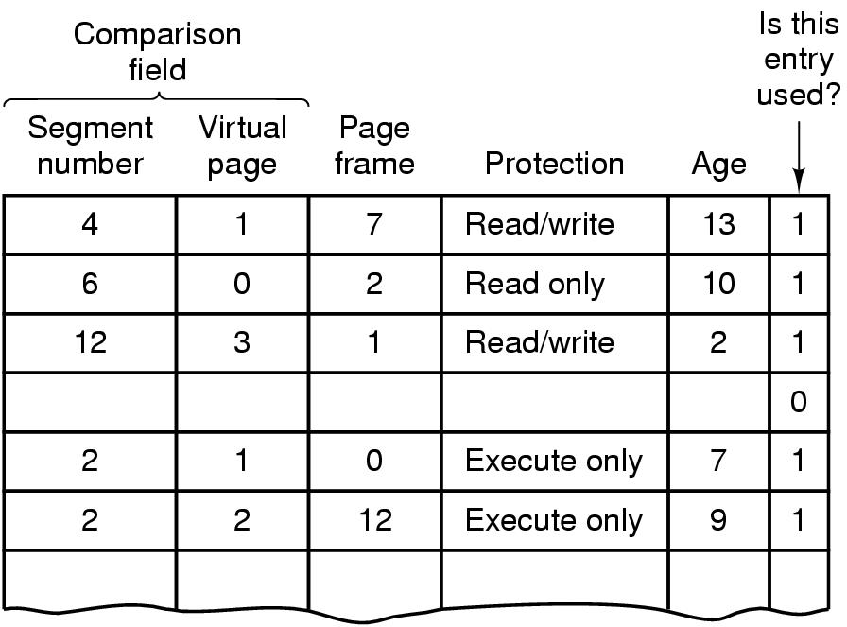
Segmentation with Paging: TLB operation
Simplified version of the MULTICS TLB
Existence of 2 page sizes makes actual TLB more complicated

Slide 29
Spare slides

Slide 30
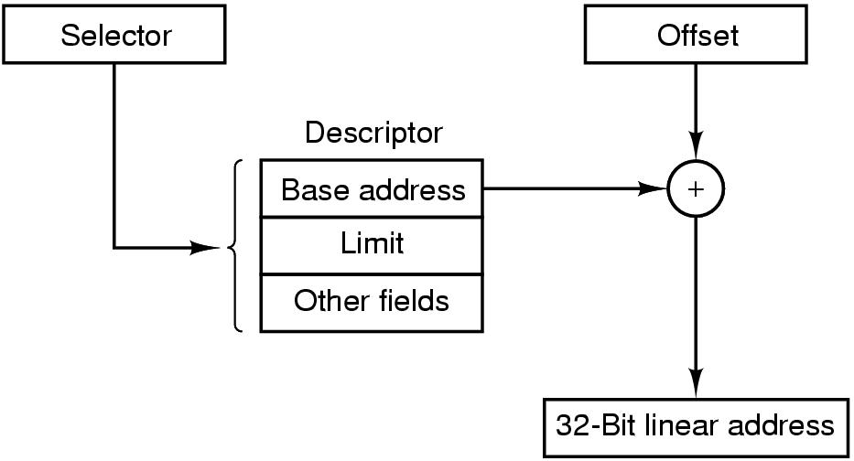
Segmentation & paging in the Pentium
Conversion of a (selector, offset) pair to a linear address

Slide 31
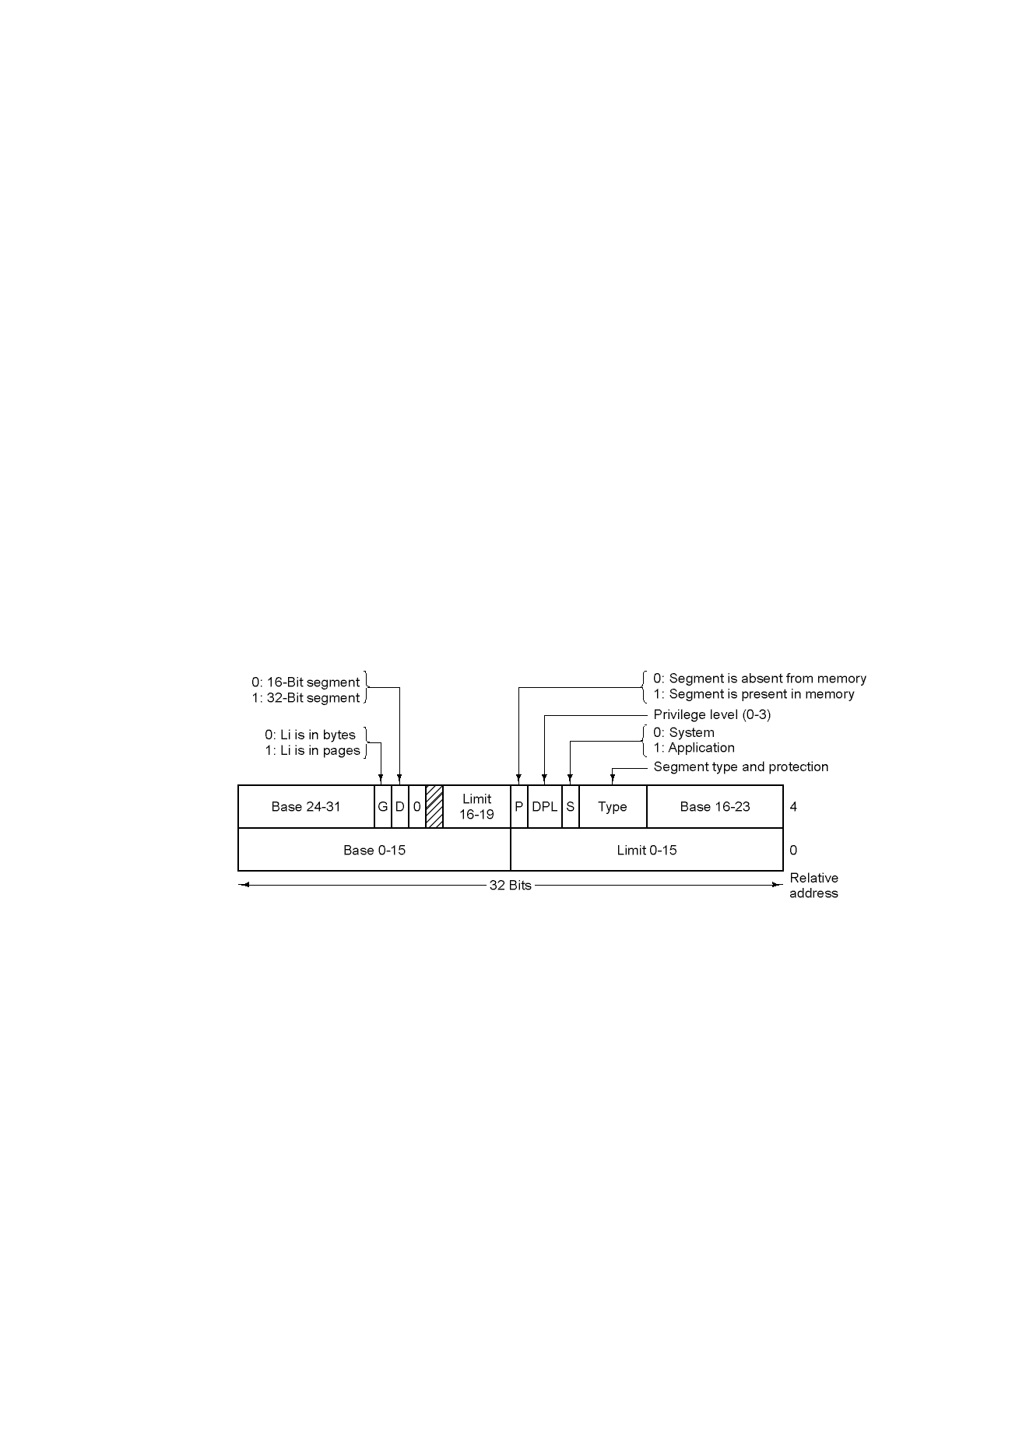
Segmentation & paging in the Pentium
Pentium segment descriptor

